Slide 1

BITN Group Undergraduate research Midterm symposium
Name: Ian Knight
Date: 04/21/2023

Slide 2
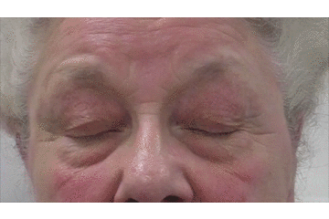

Project overview
Subtypes
Flutters
Full/Partial
Apraxia of eyelid opening
Upper facial spasm
Lower facial spasm
Both spasm
Title: Deep phenotyping in blepharospasm (BSP)
Aim: classifying subtypes of BSP using EOG/EMG
Tasks
A Unsupervised pattern discovery
Network-based clustering
B Design of patch type device
Sample image
https://mrdavidcheung.com/functional/blepharopspasm.html
Why unsupervised learning?
In the diagnosis of BSP, inconsistent diagnosis criteria from doctor-to-doctor introduces variation in outcomes for BSP diagnosis largely owing to human element.
Unsupervised learning methods do not require a ground truth to map data onto; they identify patterns in data un-augmented.

Slide 3
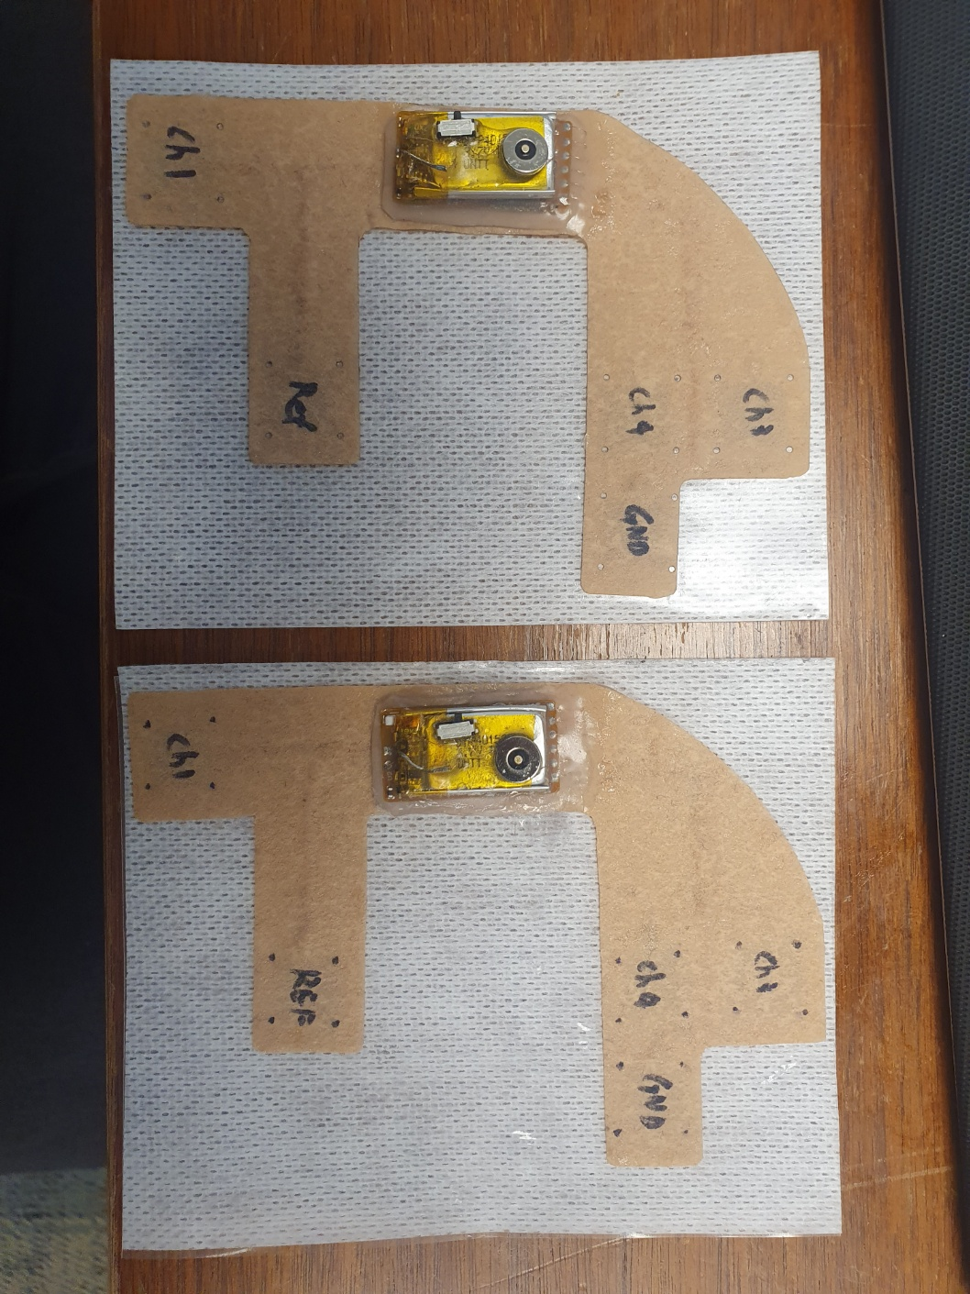
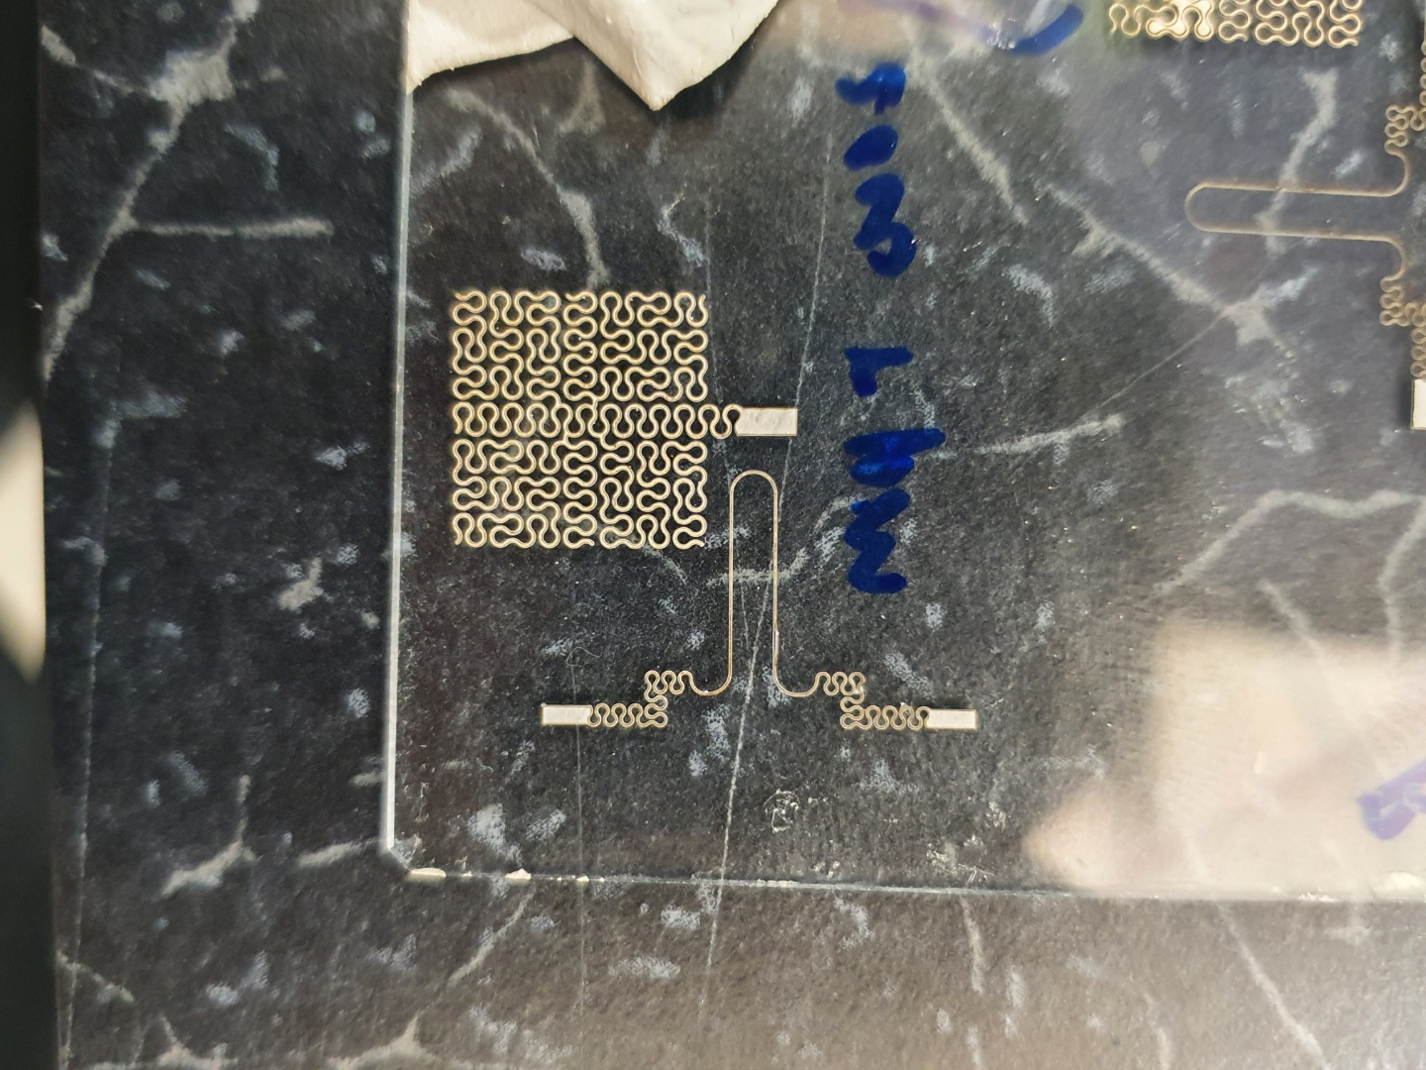
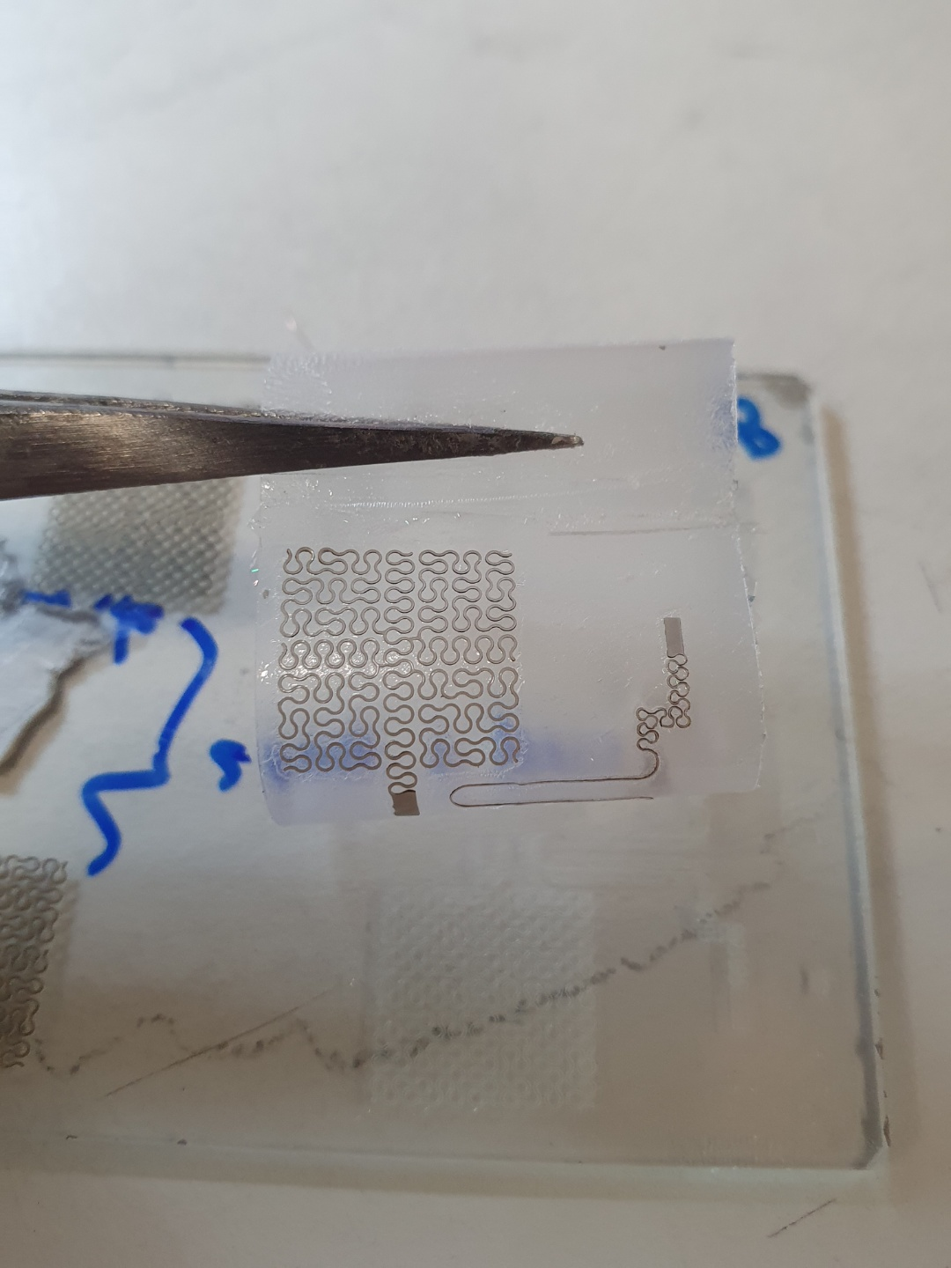
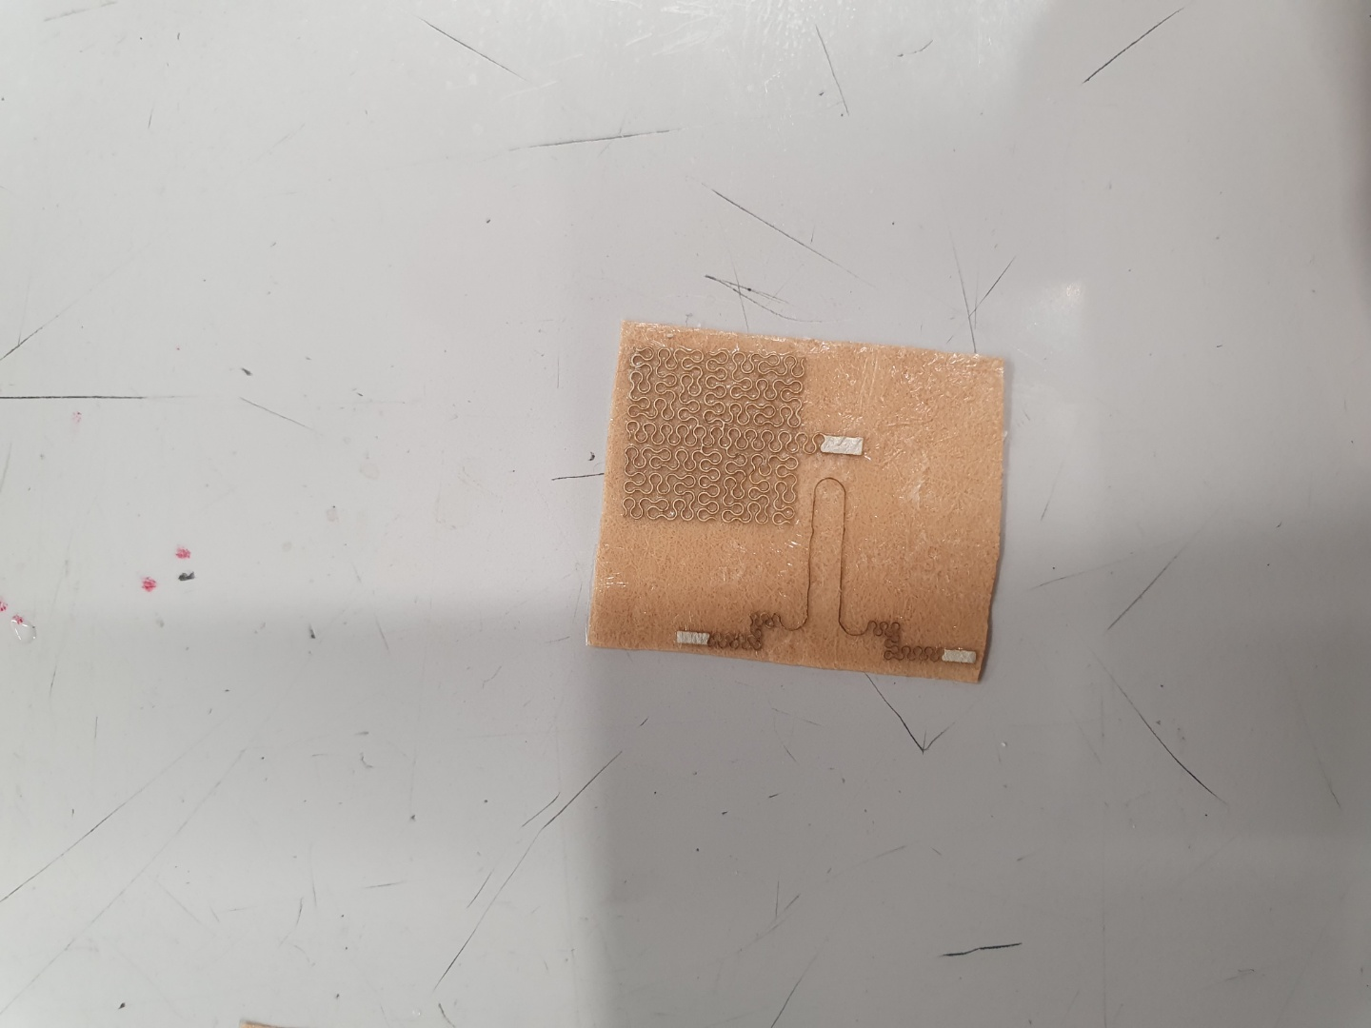
B : Designing and fabrication of new patch-type device
I started with in-lab fabrication of physical devices recently.
Practiced assembly of flexible-backing boards.
Have not fabricated any real devices.
Laser patterning
Transfer using water soluble tape

Slide 4
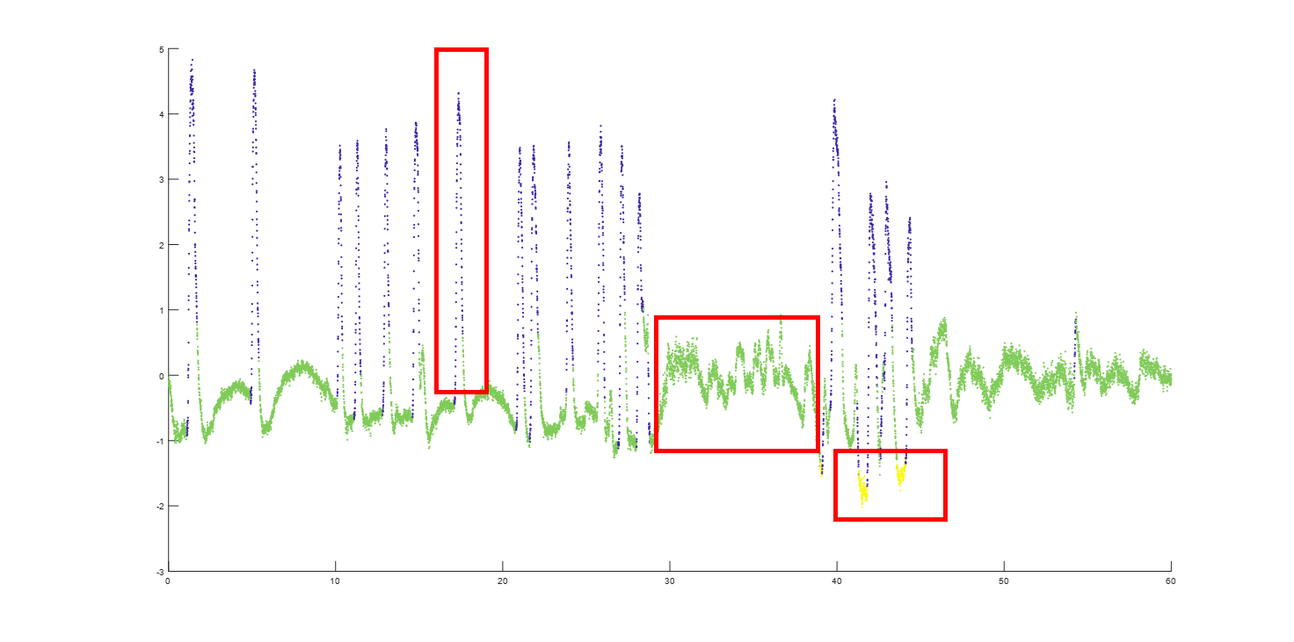
Unsupervised pattern discovery
Ultimate Goal : Clustering Labels
Previous development work:
Single-channel
Timeseries
w/ CAE, anomaly detection
New data is:
Multichannel
Timeseries
Start at:
Single-Channel
Timeseries
Representative example
EOG+EMG
Time

Slide 5
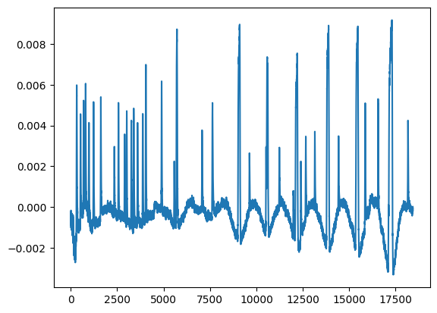
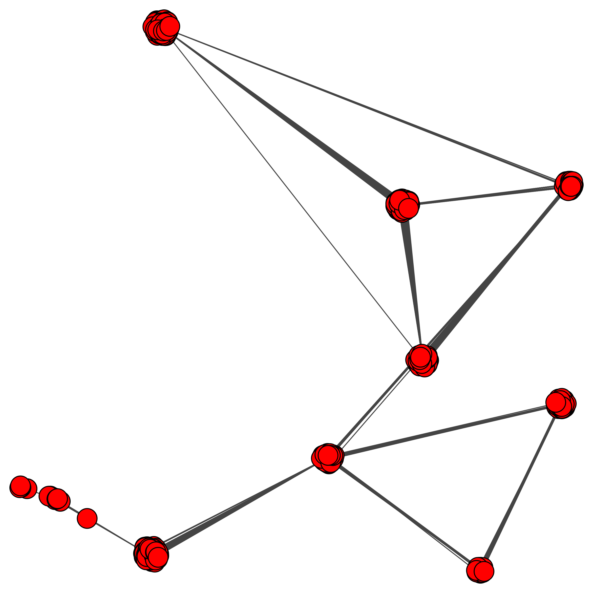
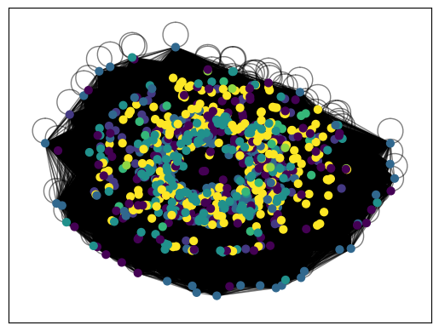
Current Network Based Clustering
Data segment
Visibility graph
Distance matrix
Distance matrix containing distance of each node from every other node (N x N)
Initial result, does not make much sense. Original algorithm clustered entire signals, so changes must be made to logic.
Convert distance matrix to “similarity matrix” then to weighted graph, then Louvain algorithm for clustering

Slide 6
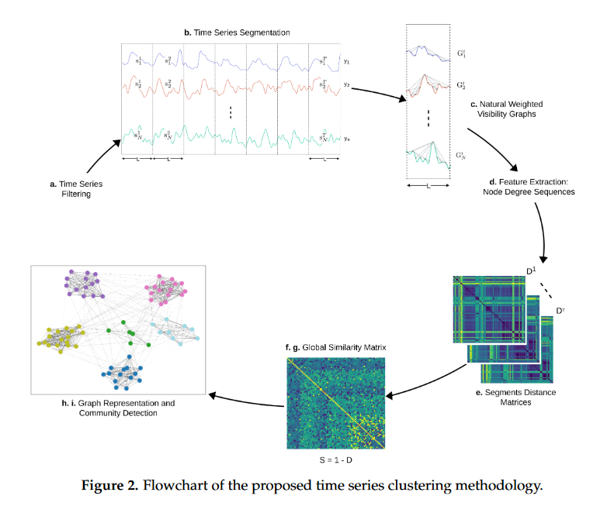
Challenges
Problems
I was trying to extend clustering labels to entire timeseries.
When the reference paper’s algorithm clustered entire signals.
To modify the algorithm, “separate signals” were now segments of the same signal, and each was to be a clustering label.

Slide 7
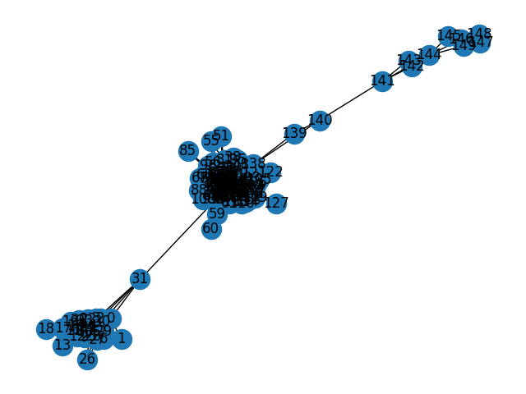
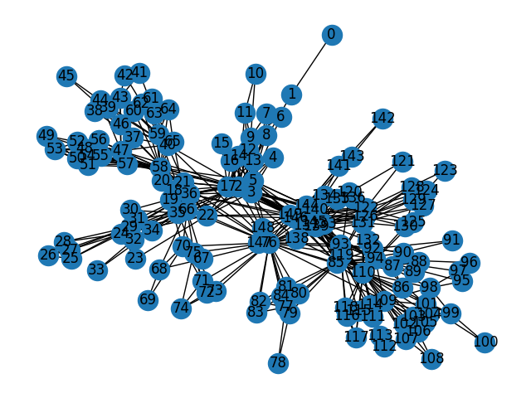
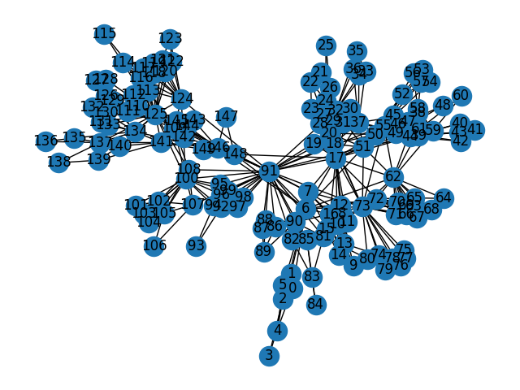
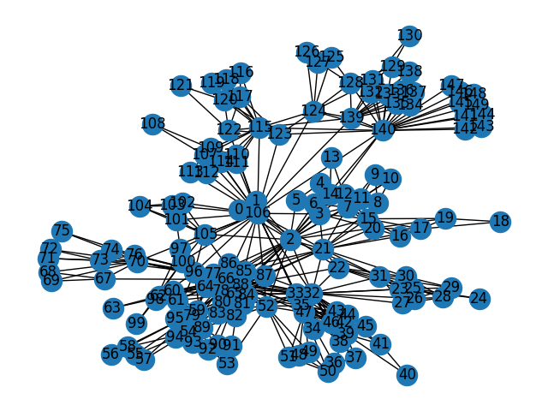
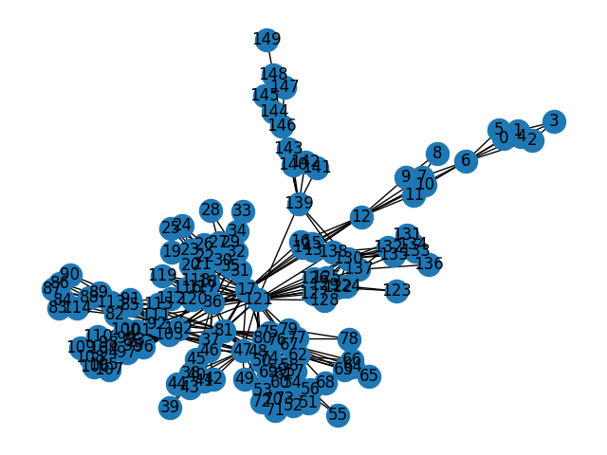
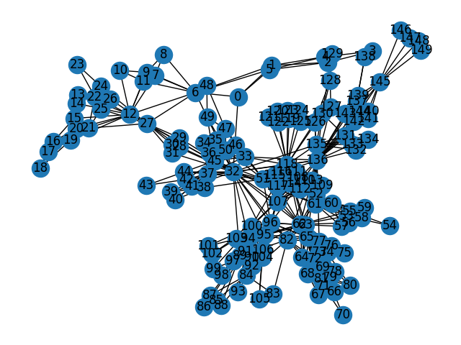
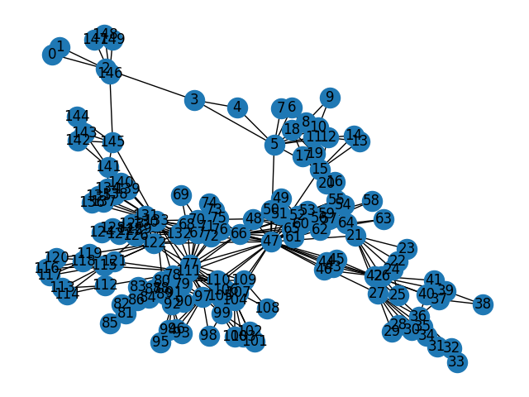
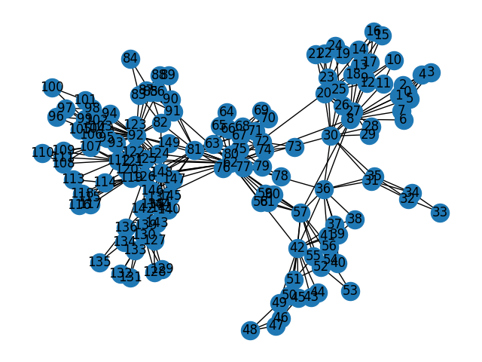
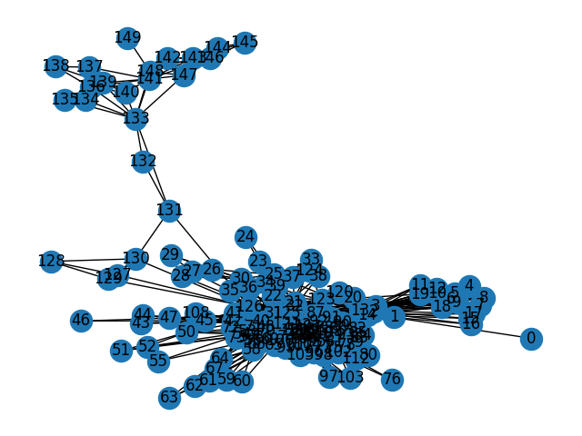
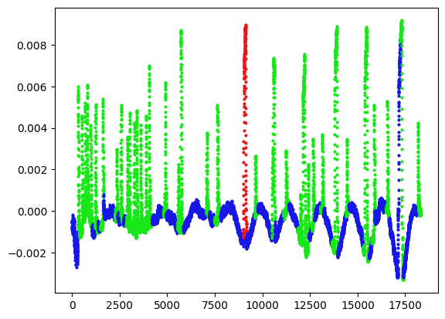
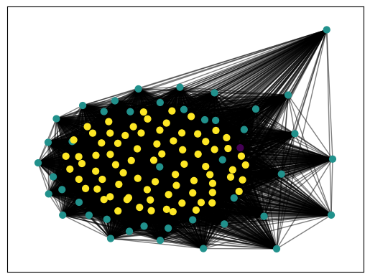
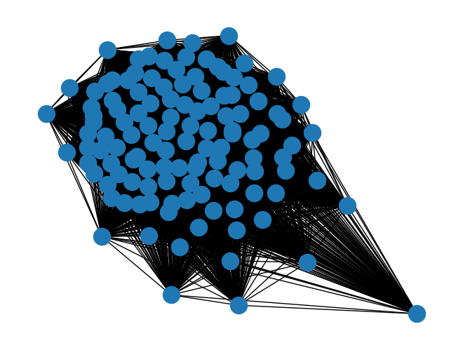
Single Channel Network Based Clustering
Data segments
Visibility graphs
Feature Vectors (DS)
Distance matrices
Generate a degree sequence to act as a feature vector of the graphs.
Each node V (a timestep) has a degree (number of connected nodes) where those connection are visible nodes, in this case.
Generate a set of distance matrices, composed of the Euclidian distance of every feature vector to every other feature vector.
Size N*N*N, where N is number of segments
Similarity Matrix
Cluster with Louvain's Algorithm
Average those distance matrices and normalize them.
Then, construct a weighted graph where each segment is a node and the normalized distance is their weight.
Much more reasonable clustering
Generated 122 segments of length 150 with overlap of 0 in a timeseries of length 18434

Slide 8
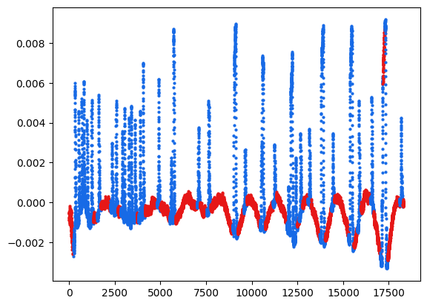
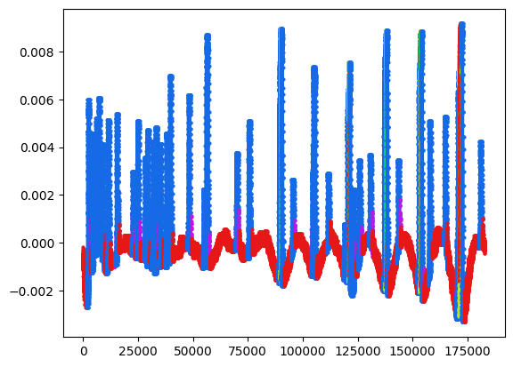
Overlap and Majority Voting
With Majority Voting
With 90% Overlap
Generated 1219 segments of length 150 with overlap of 135 in a timeseries of length 18434

Slide 9
Multichannel Data
Deep phenotyping in BSP using EOG/EMG signals
Eye blink
Eye squeezing
Opening eyes as wide as possible

Slide 10
Multichannel Clustering
Eye blink
Multichannel support will be achieved in one of two ways:
Through appending the signals end to end and segmenting them as a single signal (proven to work). Then, generating distance matrices for each signal and averaging across all those to a single global distance matrix.
Through averaging the resulting global distance matrices for each timeseries individually.
Both methods are highly expensive in terms of memory and difficult to get running in high dimension testing.
Eye squeezing
Opening eyes as wide as possible

Slide 11
What’s Next?
True multichannel clustering success
Once we land on suitable labels for each timeseries, we can use those labels in a supervised process, e.g., a CNN.
Memory optimization with tools like h5py, to run larger dimensions tests on a laptop.

